Slide 1
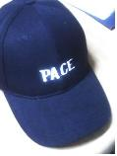



Equipping & Caring
To equip the saints
For the Ministry
melvinuniv.org
Lay Pastors Ministry PACE
GOOD to GREAT
Seoul Korea
Kenya Africa

Slide 2
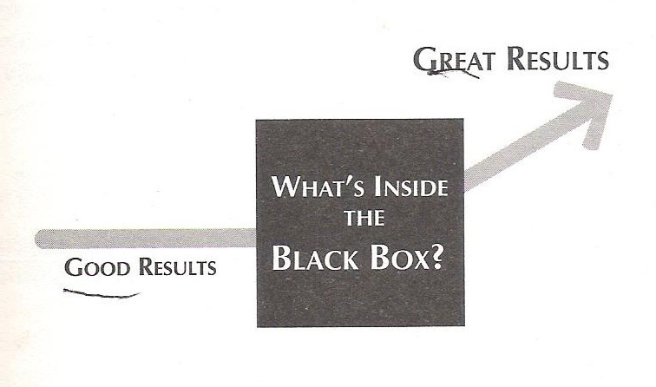
INTRODUCTION
Prayer-Available-Contact-Example

Slide 3
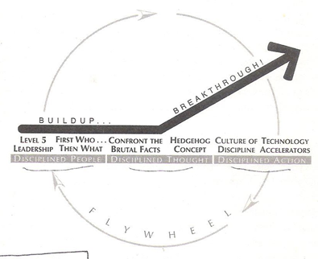
INTRODUCTION
Prayer-Available-Contact-Example

Slide 4
1. Level 5 Leadership
You can accomplish anything in life, provided that you do not mind who gets the credit. -Herry S. Truman.
They are self-effacing, quiet, reserved, even shy--these leaders are a paradoxical blend of personal humility and professional will. They are more like Lincoln and Socrates than Patton or Caesar.
Prayer-Available-Contact-Example

Slide 5
-continued
Level 5: Level 5 Executive
Paradoxical blend of personal humility and professional will
Level 4: Effective Leader
Catalyzes commitment to and vigorous pursuit of a clear and compelling vision, stimulating higher performance standards.
Level 3: Competent Manager
Organize people and resources toward the effective and efficient pursuit of predetermined objectives.
Level 2: Contributing Team Member
Contribute individual capabilities to the achievement of group objectives and works effectively with others in a group setting.
Level 1: Highly Capable Individual
Makes productive contributions through talent, knowledge, skills, and good work habits.
Prayer-Available-Contact-Example

Slide 6
-continued
Level 5 leaders channel their ego needs away from themselves and into the larger goal of building a great ministry. It's not that Level 5 leaders have no ego or self-interest. Indeed, they are incredibly ambitious - but their ambition is first and foremost for the ministry/institution, not themselves.
All the great ministry/organization had Level 5 leadership at the time of transition.
HUMILITY + WILLFUL = LEVEL 5
Level 5 leaders are a study in duality: modest and willful, humble and fearless.
They look out the window to apportion credit to factors outside themselves when things go well (and if they cannot find a specific person or event to give credit to, they credit good luck, means God's grace). At the same time, they look in the mirror to apportion responsibility, never blaming bad luck when things go poorly.
Prayer-Available-Contact-Example

Slide 7
2. First Who...Then What
We found that first got the right people on the bus, the wrong people off the bus, and the right people in the right seats--and then they figured out where to drive it.
The old adage "People are your most important asset" turns out to be wrong. People are not your most important asset. The right people are.
Mostly we think that to be great would be to set a new direction, a new vision and strategy for the ministry, and then get people committed and aligned behind that new direction. But actually something quite the opposite.
There is three simple truth.
First, if we begin with "who," rather than "what," we can more easily adapt to a changing world.
"If we need to change direction to be more successful, fine with me."
Prayer-Available-Contact-Example

Slide 8
-continued
Second, If we have right people on the bus, the problem how to motivate and manage people largely goes away. The right people don't need to be tightly managed of fire up; they will self motivated by the inner drive to produce the best result and to be part of creating something great.
Third, If we have wrong people, it doesn't matter whether we discover the right direction; we still won't have a great ministry. Great vision without great people is irrelevant.
Level 4 Leader: Frist What, then Who
Level 5 Leader: First Who, then What
The people from the great ministry/organization/institution clearly loved what they did, largely because they loved who they did it with.
Prayer-Available-Contact-Example

Slide 9
3. Confront the Brutal Facts
(Yet Never Lose Faith)
There is no worse mistake in public leadership than to hold out false hopes soon to be swept away. -Winston S. Churchill
Every great organization embraced that what we came to call the Stockdale Paradox: We must maintain unwavering faith that you can and will prevail in the end, regardless of the difficulties, AND at the same time have the discipline to confront the most brutal facts of your current reality, whatever they might be.
Facts are better than dream
The breakthrough results come about by a series of good decisions, diligently executed and accumulated one on top of another. They made many more good decisions than bad ones.....of course than other organizations. It turns out, is that there was something quite distinctive about their process: two disciplined thought.
Prayer-Available-Contact-Example

Slide 10
-continued
The first is that they infused the entire process with the brutal facts of reality.
The second is that they developed a simple, yet deeply insightful, frame of reference for all decision.
We cannot make a series of good decisions without first confronting the brutal facts.
Brutal facts? reality? how to motivate people with these...?
If you have the right people on the bus, they will be self-motivated.
False hope is more serious problem...
Yes. Leadership is about vision. But also need to be heard where the truth is...
How?
1. Lead with questions, not answers.....right people one the bus?
2. Engage in dialogue and debate, not coercion....
3. Conduct autopsies, not blame....mistake? lessons?
4. Information, information cant not be ignored........
Prayer-Available-Contact-Example

Slide 11
-continued
Unwavering Faith amid the Brutal Facts
In confronting the brutal facts, to great ministry/organization left themselves stronger and more resilient, not weaker and more dispirited.
People fell generally into three categories:
1. Those who were permanently dispirited by the event,
2. Those who got their life back to the normal
3. Those who used the experience as a defining event that make them stronger.
Paradox to be great
Accepted the brutal facts of reality unwavering faith
Maintained an unwavering faith in the endgame.
Retain faith that you will prevail in the end, regardless of difficulties
AND at the same time
Confront the most brutal facts of our current reality, whatever they might be.
Prayer-Available-Contact-Example

Slide 12
4. The Hedgehog Concept
If we cannot be the best in the world at our core ministry, then our core ministry absolutely cannot form the basis of a great organization.
Are you a hedgehog or a fox?
Ancient Greek parable: "The fox know many things, but the hedgehog knows one big things."......to divide people into two basic groups: foxes and hedgehogs.
Foxes pursue many ends at the same time and see the world in all its complexity. They are "scattered or diffused, moving on many levels...never integrating their thinking into one overall concept or unifying vision.
Hedgehogs, on the other hand, simplify a complex world into a single organizing idea, a basic principle or concept that unifies and guides everything.
Prayer-Available-Contact-Example

Slide 13
-continued
To be clear, hedgehog is not stupid. Quite the contrary.
They understand that essence of profound insight is simplicity. What could be more simple than e=mc²? What could be simpler than the idea of the unconscious, organized into an id, ego, and superego?
No, the hedgehogs aren't simpleton; they have a piercing insight that allows them to see through complexity and discern underlying patterns. Hedgehog see what is essential, and ignore the rest.
More precisely, a Hedgehog concept is a simple, crystalline concept that flows from deep understanding about the intersection of the followings: 1) what I am deeply PASSIONATE ABOUT, 2) what I can BE THE BEST IN THE WORLD at, 3) Is it GOD WANTED to do to do.
A hedgehog concept is not a goal to be the best, a strategy to be the best, an intention to be the best, a plan to be the best. It is an understanding of what we can be the best at. The distinction is absolutely crucial.
Prayer-Available-Contact-Example

Slide 14
-continued
A hedgehog concept is not a goal to be the best, a strategy to be the best, an intention to be the best, a plan to be the best. It is an understanding of what we can be the best at. The distinction is absolutely crucial.
There is pre-hedgehog and post-hedgehog.
Pre-hedgehog: It's like groping through fog....you can't see all that well….only a little bit ahead.... move at a deliberate, slow crawl.
Post-hedgehog: ...move swiftly beneath your feet, ...fly past as you quickly make decision..
Disciplined people, disciplined thought....make Hedgehog concept into reality.
Essential point: "Growth!" is not a Hedgehog concept. Rather, if we have the right Hedgehog concept and make decisions relentlessly consistent with it, we will create such momentum that our main problem will not be how to grow, but how not to grow too fast.
Getting a Hedgehog concept is an inherently iterative process, not an event.
Prayer-Available-Contact-Example

Slide 15
5. A Culture of Discipline
Freedom is only part of the story and half the truth.....That is why I recommend that the Statue of Liberty on the East Coast by supplanted by a Statue of Responsibility on the West Coast. -Viktor E. Frankl
All organizations have a culture, some have discipline, but few have a culture of discipline. When we have disciplined people, we don't need hierarchy. When we have disciplined thought, we don't need bureaucracy. When we have disciplined action, we don't need excessive controls.
Few successful start-ups become great ministry, in large part because they respond to growth and success in the wrong way. Entrepreneurial success is fueled by creativity, imagination, bold moves into uncharted waters, and visionary zeal.
As a ministry/organization grows and becomes more complex, it begins to trip over its own success - too many new people, to many new customers, too many new orders, too many new products. What was once great fun becomes unwieldy ball of disorganized stuff..
Prayer-Available-Contact-Example

Slide 16
-continued
Lack of planning, lack of accounting, lack of system, and lack of hiring constraints create fiction. Problem surface - with customers, with cash flow, with schedules.
People says "it's time to grow up. This place needs some professional management."
They come and tried help, but they also kill the entrepreneurial spirit. Members of founding team begins to grumble, "This isn't fun anymore." The creative magic begins to wane as some of the most innovative people leave, disgusted by the burgeoning bureaucracy and hierarchy.
The small percent of wrong people on the bus is the problem. If they are getting more, then right people is getting small percent.
Build a culture full of people who take disciplined action within the three circles, fanatically consistent with the Hedgehog Concept.
Prayer-Available-Contact-Example

Slide 17
-continued
More preciously, this means the following:
Build a culture around the idea of freedom and responsibility, with a framework.
Fill that culture with self-disciplined people who are willing to go to extreme lengths to fulfill their responsibilities. They will "rinse their cottage cheese." ex.)They don't need diet. Good enough shape, but keep on training, self-disciplining.
Don't confuse a culture of discipline with a tyrannical disciplinarian.
4. Adhere with great consistency to the Hedgehog
Concept, exercising an almost religious focus on the intersection of the three circles.
Freedom (and responsibility) within a framework.
Great organization hire self-disciplined people who didn't need to be managed, and then managed the system, not the people.
It all starts with disciplined people. They have to be on the bus first.
Next, disciplined thought.
Last, disciplined action.
Prayer-Available-Contact-Example

Slide 18
-continued
Rinsing Your Cottage Cheese
Every one would like to be the best, but most ministry/organizations lack the discipline to figure out with egoless clarity what they can be the best at and the will to do whatever it takes to turn that potential into reality. They lack the discipline to rinse their cottage cheese.
A culture, not a tyrant
Great organizations became more disciplined.
They needed an enduring culture of discipline.
Indeed, a great organization is much more likely to die of indigestion from too much opportunity than starvation from too little. The challenge becomes not opportunity creation, but opportunity selection.
It takes discipline to say "No, thank you" to big opportunities.
It is due to its ability to translate its simple concept into disciplined action consistent with that concept.
Prayer-Available-Contact-Example

Slide 19
-continued
This order is important
Prayer-Available-Contact-Example

Slide 20
-continued
Rinsing Your Cottage Cheese
Every one would like to be the best, but most ministry/organizations lack the discipline to figure out with egoless clarity what they can be the best at and the will to do whatever it takes to turn that potential into reality. They lack the discipline to rinse their cottage cheese.
A culture, not a tyrant
Great organizations became more disciplined.
They needed an enduring culture of discipline.
Indeed, a great organization is much more likely to die of indigestion from too much opportunity than starvation from too little. The challenge becomes not opportunity creation, but opportunity selection.
It takes discipline to say "No, thank you" to big opportunities.
It is due to its ability to translate its simple concept into disciplined action consistent with that concept.
Prayer-Available-Contact-Example

Slide 21
-continued
Start a "stop doing" list.
Do you have a "to do" list?
Do you also have a "stop doing" list?
If you look on the great organizations, they disciplined remarkable courage to channel their resources into only one or a few arenas.
Prayer-Available-Contact-Example

Slide 22
6. Technology Accelerators
"New technology will change everything," the logic went. The internet is going to completely revolutionize all ministry/organization....Be there first, be there fast, build market....
How will the Internet connect to our Hedgehog Concept?
The real question is not, What is the role of technology? Rather, the real question is, How do to good ministry/organizations think differently about technology?
Technology as a accelerator, Not a Creator, of Momentum
Great ministry/organization never began their transitions with pioneering technology, for the simple reason that we cannot make good use of technology until you know which technology are relevant.
And which are those?.. only those that link directly to the Hedgehog concept.
We shouldn't be trapped at the technology.
We need it, but make limitation.
Prayer-Available-Contact-Example

Slide 23
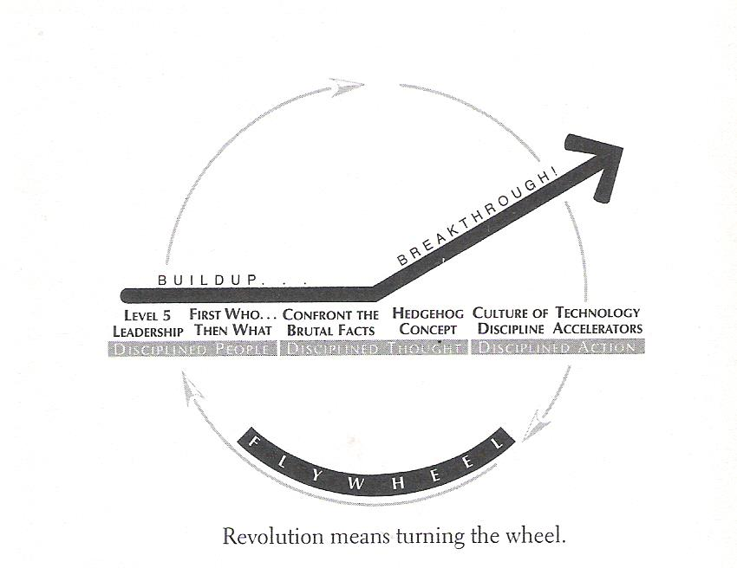
The Flywheel and the Doom Loop
-Igor Stravinsky
Prayer-Available-Contact-Example

Slide 24
-continued
No matter how dramatic the end result, the great transformations never happened in one fell swoop.
There was no single defining action, no grand program, no one killer innovation, no solitary lucky break, no miracle moment.
Rather the process resembled relentlessly pushing a giant heavy flywheel in one direction, turn upon turn, building momentum until a point of breakthrough, and beyond.
Now imagine that your task is to get the flywheel rotating on the axle as fast and long as possible.
Pushing with great effort, we get the flywheel to inch forward, moving almost imperceptibly at first. You keep pushing and, after two or three hours of persistent effort, you get the flywheel to complete one entire turn.
Prayer-Available-Contact-Example

Slide 25
-continued
You keep pushing, and the flywheel begins to move a bit faster.....continued great effort....three turns....four... five....ten...it builds momentum...moving faster with each turn...twenty....fifty...a hundred.
Then, at some point - breakthrough! ....its own heavy weight working for you....the flywheel goes faster and faster...You are pushing no harder than during the first rotation..
Build and Breakthrough!
The flywheel image captures the overall feel of what it was like inside the ministry/organization as they went from good to great.
No matter how dramatic the end result, the great transformations never happened in one fell swoop. There was no single defining action, no grand program, no one killer innovation, no solitary lucky break, no miracle moment. Rather the process resembled relentlessly pushing a giant heavy flywheel in one direction, turn upon turn, building momentum until a point of breakthrough, and beyond.
Prayer-Available-Contact-Example

Slide 26
-continued
To Great comes about by a cumulative process - step by step, action by action, decision by decision, turn by turn of the flywheel - that adds up to sustained and spectacular results.
The way transitions from outside,
They must feel like to those going through them on the inside.
From the inside, they feel completely different, more like an organic development process.
The transformation of Egg to Chicken!
-evolving, growing, developing, incubating...cracking the egg is simply one more step in a long chain of steps leading up to that moment....
There was no launch event, no tag line, no programmatic feel whatsoever. They weren't even aware that a major transformation was under way until they were well into it.
It was often more obvious to them after the fact than at the time.
There was no miracle moment.
Prayer-Available-Contact-Example

Slide 27
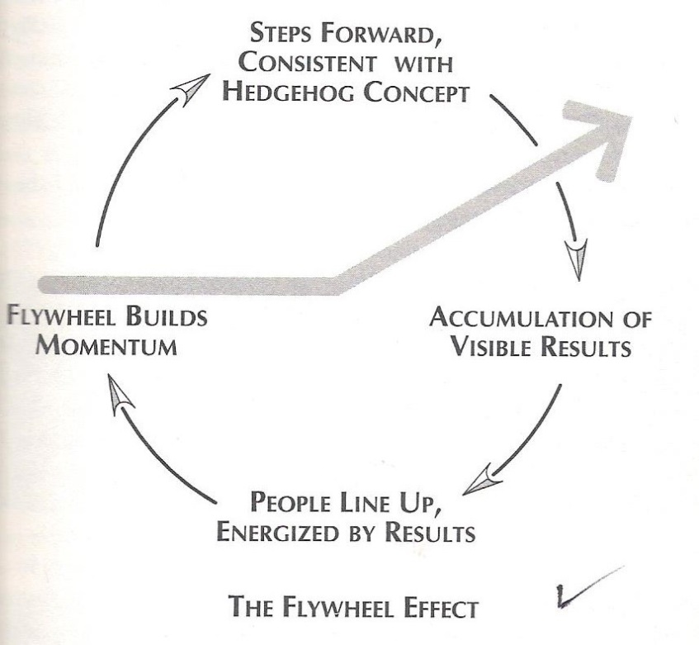
-continued
The "flywheel effect“
Tremendous power exists in the fact of continued improvement and the delivery of results.
How these steps fit into the context of an overall concept that will work. When we do this in such a way that people see and feel the build of momentum, they will line up with enthusiasm. This calls flywheel effect, and it appears not only to outside but also internal groups.
Prayer-Available-Contact-Example

Slide 28
-continued
b) The Doom Loop
But some frequently launched new programs - often with great fanfare and hoopla aimed at "motivating the troops" - only to see the programs fail to produce sustained results.
They sought the single defining action, the grand program, the one killer innovation, the miracle moment that would allow them to skip the arduous buildup stage and jump right to breakthrough....one direction, then stop, change course, and throw it in a new direction - an then they would stop, change course....repetition the mistake…
Finally...failed to build sustained momentum and fell instead into what to call Doom Loop.
Prayer-Available-Contact-Example

Slide 29
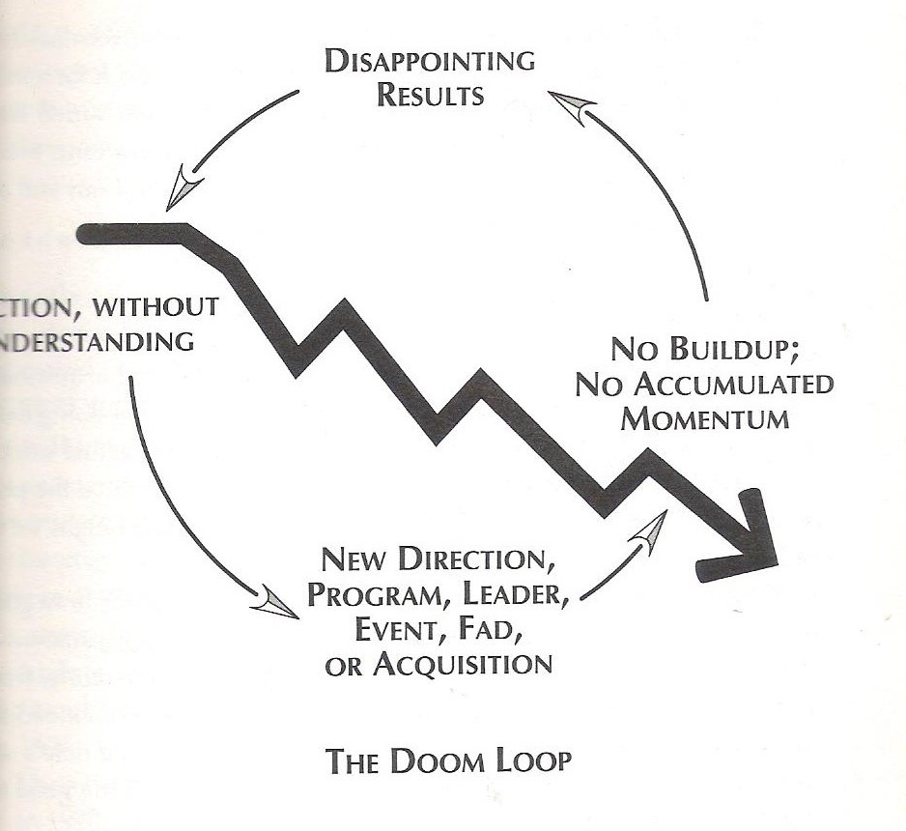
-continued
Prayer-Available-Contact-Example

Slide 30
-continued
Level 5 leader
2. Getting right people
3. Flywheel
Hit breakthrough momentum---Discipline and hedgehog concept
Prayer-Available-Contact-Example

